Slide 1
Notes:
Thank you all for your feedback this week. We’ll be doing this week a little bit differently

Slide 2
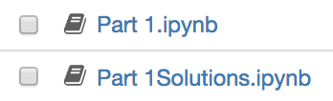
Notes:
We have provided solutions for each section, so if you get stuck on any challenges, you can continue working forward.

Slide 3

Notes:
We’re also gonna do more slides now, because it’ll help me explain some of the code much better.

Slide 4
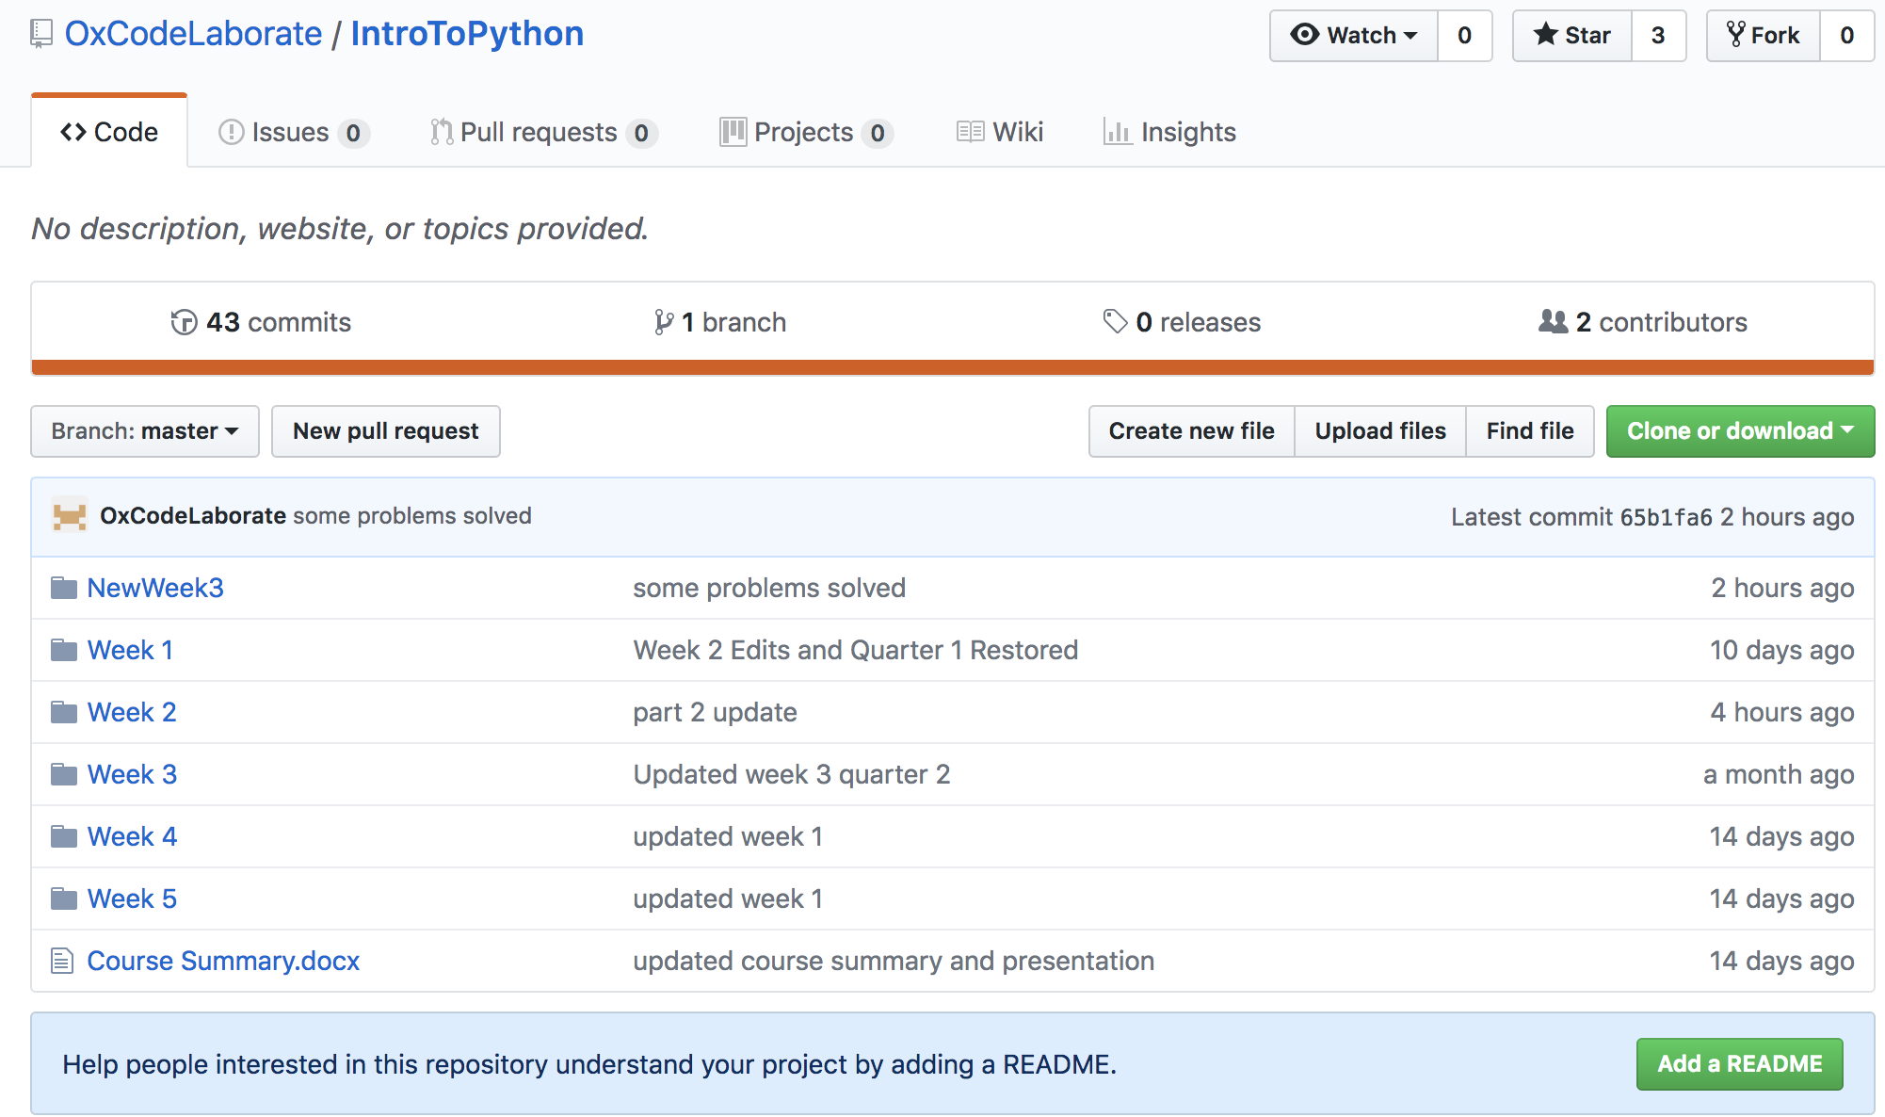
https://github.com/OxCodeLaborate/IntroToPython
Notes:
So now we’re gonna go to github and do the same madness of downloading

Slide 5
https://github.com/OxCodeLaborate/IntroToPython
Notes:
So now we’re gonna go to github and do the same madness of downloading

Slide 6

https://github.com/OxCodeLaborate/IntroToPython
Notes:
Unzip the file

Slide 7
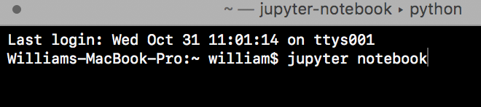
https://github.com/OxCodeLaborate/IntroToPython
Windows
Open Anaconda Command Prompt
MacOS
Open Terminal

Slide 8
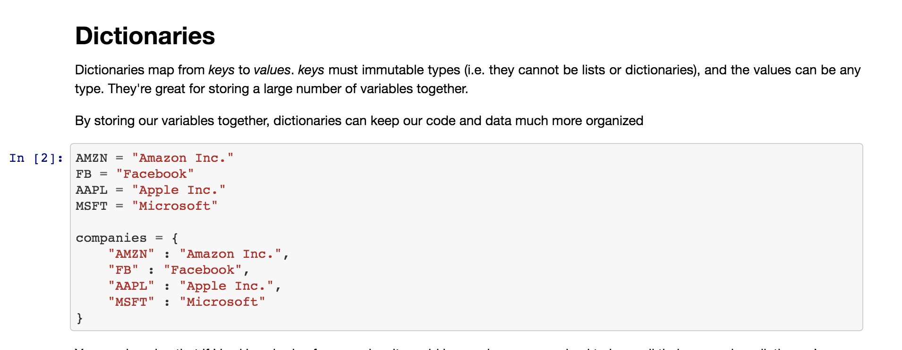
Part 1

Slide 9
Booleans
Notes:
Booleans

Slide 10

Recall that...
Notes:
Recall that with Python, we’re trying to communicate with a computer that doesn’t think the way we think....

Slide 11

Notes:
So far we’ve written some basic instruction sets, but we want to be able to dictate

Slide 12


Notes:
When the computer should do something, or under what condition

Slide 13


Notes:
For that, we borrowed a concept from mathematics called “Booleans,” and there are just two of these

Slide 14
Notes:
And in general, if the condition is True, we will run the program, execute the code, we do SOMETHING!
If the condition is False, we do nothing.

Slide 15
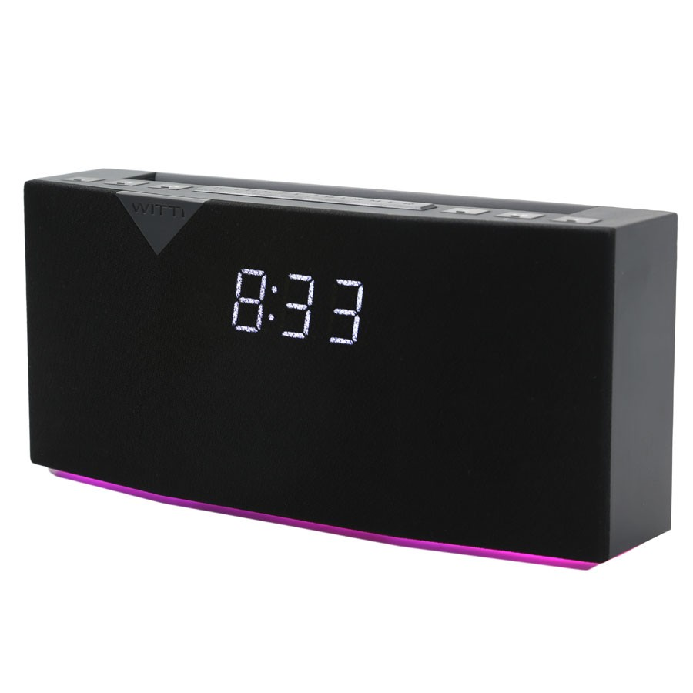
Notes:
So we can make a statement like: it’s 8:30 in the morning.
And then we can write some code that says: When that statement is True, sound the alarm.

Slide 16
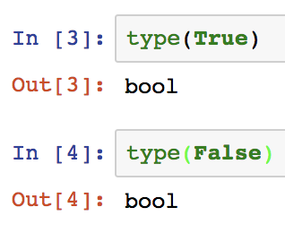
Notes:
And in Python in particular, we will consider these their very own datatype. These are the only boolean values in Python.

Slide 17
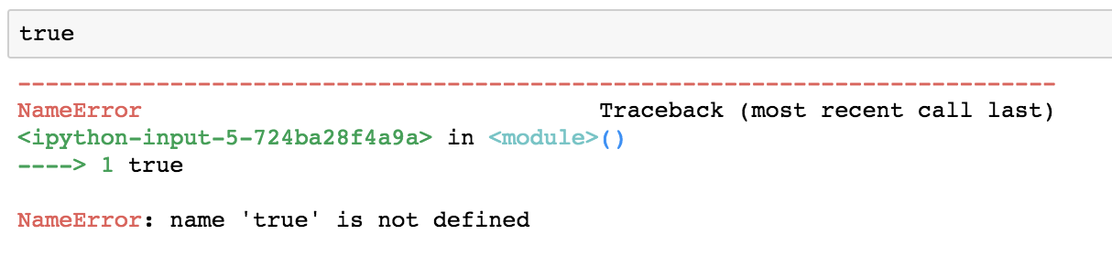
Notes:
And note that Python is case-sensitive, so keep the first letters uppercase

Slide 18


Notes:
And if Python recognizes the keyword, it’ll highlight it in green.

Slide 19
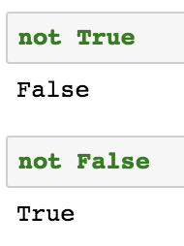
A New Operator!
Notes:
Booleans also come with their own operators. First and easiest one is Not.
Not True is False
Not False is True

Slide 20
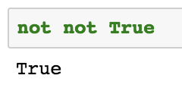
Two negatives make a positive
Notes:
Two negatives make a positive

Slide 21
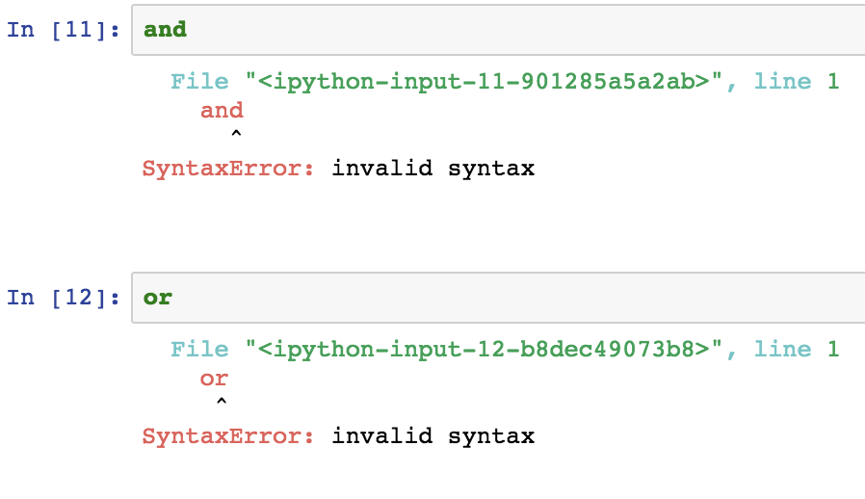
Notes:
So now we have two more boolean operators. These are “and” and “or” On their own they don’t do anything

Slide 22
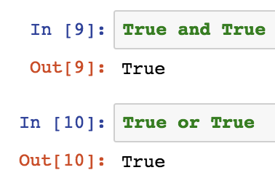
Notes:
And that’s because they expect a boolean value on the left and on the right.
True and True make True
True or True make True

Slide 23
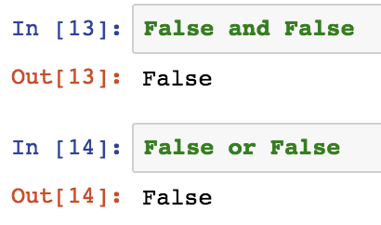
Notes:
False and False make False
False or False make False

Slide 24
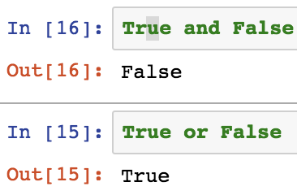
Notes:
The difference is when you combine True and False.
True and False is False
True or False is True

Slide 25
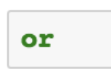
Returns True when either the left OR the right are True

Slide 26
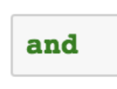
Returns True when either the left OR the right are True
Returns True when the left AND right are True

Slide 27
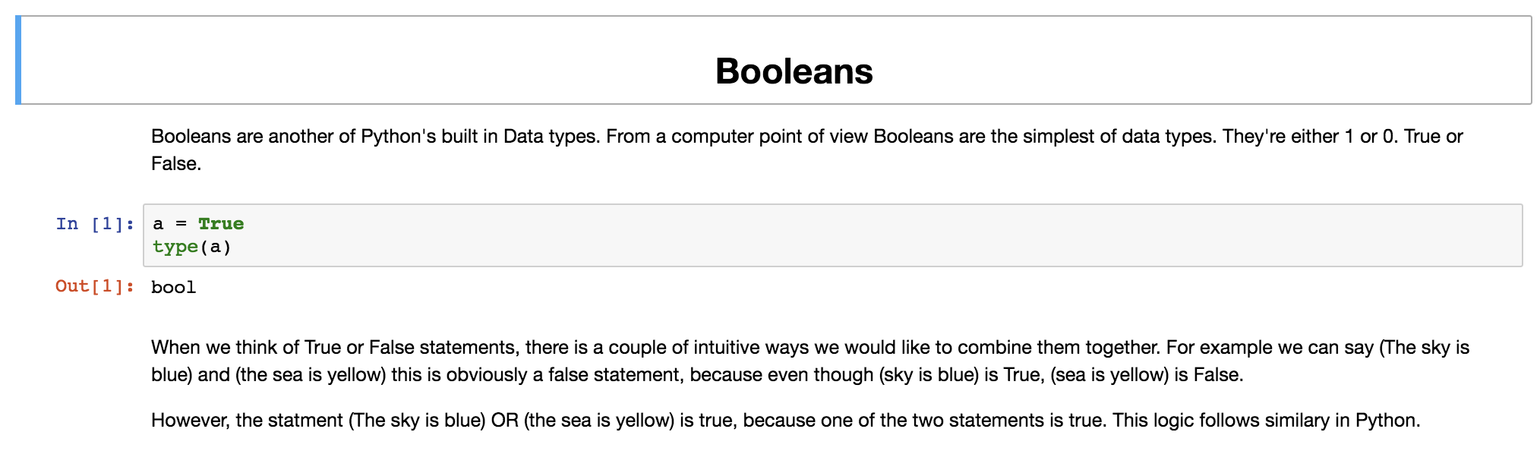
Part 2
Notes:
So go through part 2, that should be Booleans.

Slide 28
Part 2
==
in
!=
!=
Notes:
Be sure to run each line of code as you go through it. And try to understand each cell that you’re running. If you don’t, feel free to ask what it’s doing!
It’ll also introduce you to two new operators, == and != , which should be fairly straightforward.

Slide 29
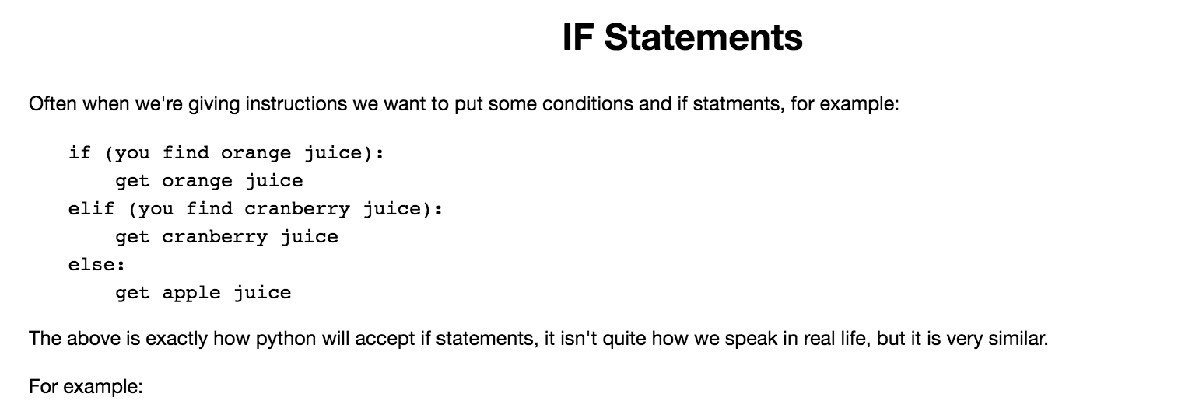
Notes:
When you hit the IF statements, you’re done.

Slide 30
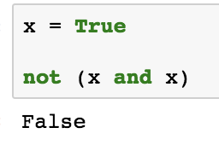
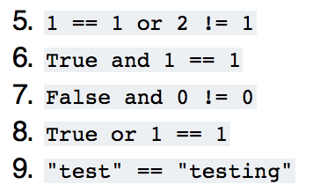
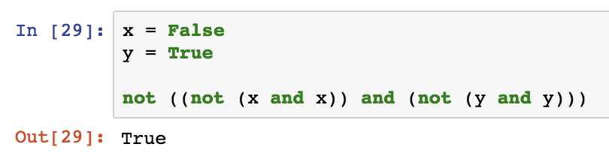
What do you think the following expressions will result in ?
What do the following expressions do?
Notes:
If you finish the built-in exercises, I have a few more up here. (12 minutes)

Slide 31
What do you think the following expressions will result in ?
What do the following expressions do?
Notes:
Just because you can write code like this, doesn’t mean you should! The easier code is to read, the better.

Slide 33

Notes:
Again, we’re gonna look inside the parenthesis:
Not x and not y is only true when x and y are both false
So the whole expression is only false when both x and y are false.

Slide 35


Slide 36
Notes:
If statements

Slide 37
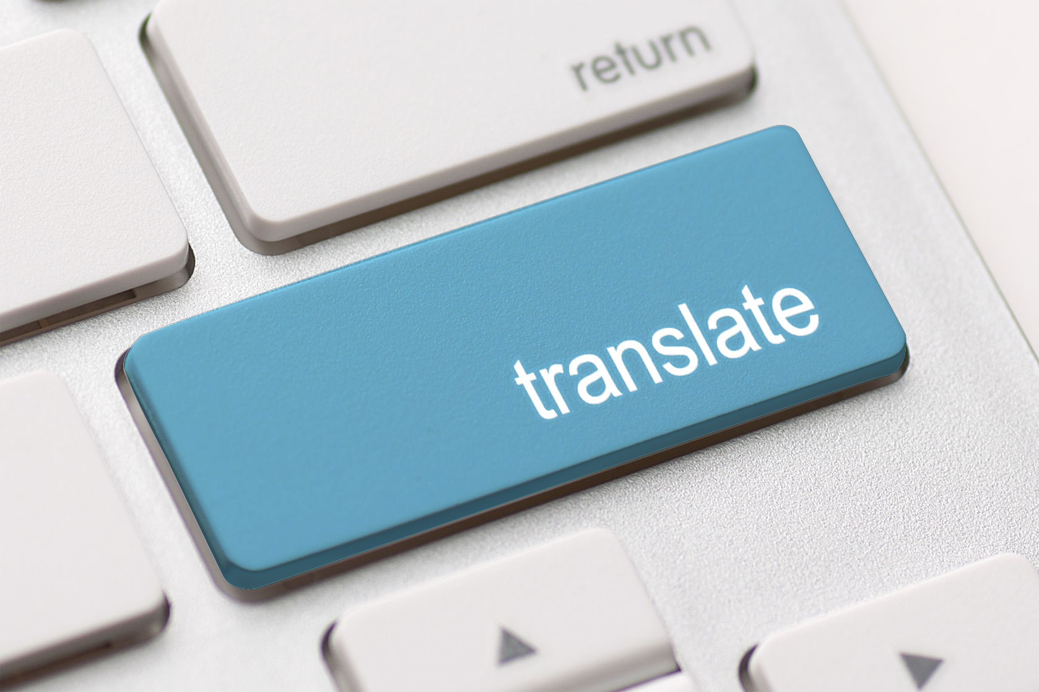
Is it 8:33?
(now.hour == 8) and (now.minute == 33)
Notes:
So we know how to make a boolean expression. We can translate simple questions into boolean expressions
To be clear this won’t work in Python, this is just an example of how we think about boolean expressions

Slide 38
It is 8:33
True
Notes:
So now we want to run some code if an expression returns True.

Slide 39
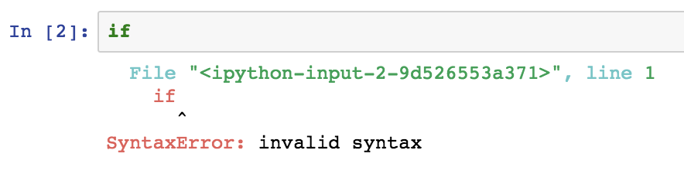
Notes:
And naturally we come to an unsurprising keyword: If.
On its own, it doesn’t do much.

Slide 40
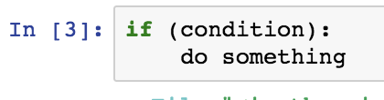
Notes:
But you can use it like this to make your code do something.
So if our boolean expression resolves to True, all the code indented below will run.

Slide 41
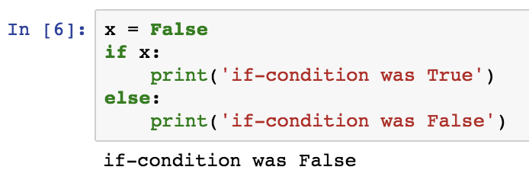
Notes:
We also have else, which essentially means “otherwise”

Slide 42
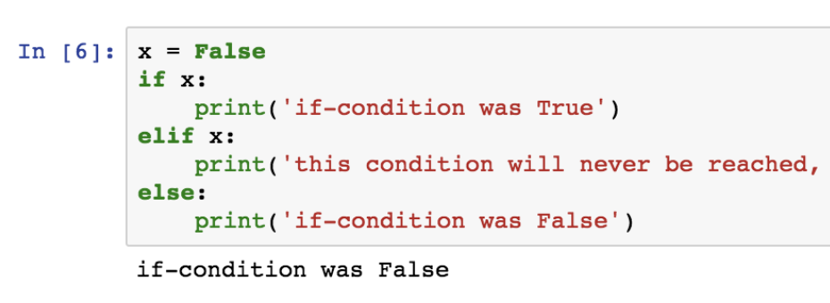
Notes:
And we have “elif”, short for “else if,” which means, “otherwise, if”

Slide 43
1
2
3
Notes:
And conditions should always come in this order:
If
elif
else

Slide 44
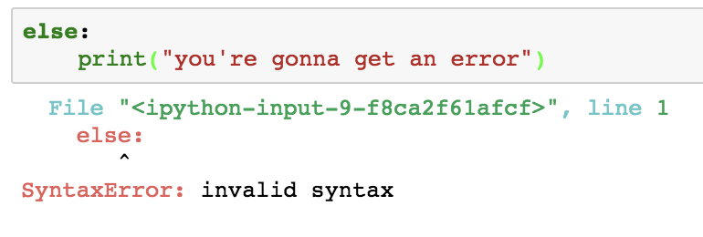
Notes:
And you had better keep to that order, else you’ll get an error

Slide 45
Memory
x = False
Notes:
Back to this code. To understand exactly what’s going on, let’s follow the order of execution. Simply, we’ll look at the code the way the interpreter does.

Slide 46
Memory
x = False
Notes:
Back to this code. To understand exactly what’s going on, let’s follow the order of execution. Simply, we’ll look at the code the way the interpreter does.

Slide 47
Memory
x = False
Notes:
Back to this code. To understand exactly what’s going on, let’s follow the order of execution. Simply, we’ll look at the code the way the interpreter does.

Slide 48
Memory
x = False
Notes:
Back to this code. To understand exactly what’s going on, let’s follow the order of execution. Simply, we’ll look at the code the way the interpreter does.

Slide 49
Memory
x = False
Notes:
Back to this code. To understand exactly what’s going on, let’s follow the order of execution. Simply, we’ll look at the code the way the interpreter does.

Slide 50

x = True
Notes:
So we’re gonna try this again but just x set to True instead

Slide 51
True
Memory
x = True

Slide 52
True
Memory
x = True

Slide 53
True
Memory
x = True
If-condition was True

Slide 54
True
Memory
x = True
If-condition was True

Slide 55
True
Program Ends

Slide 56
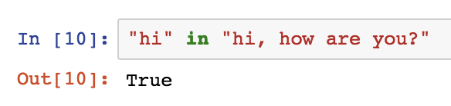
in
Notes:
So the notebook will also explain the “in” operator, which I’m sure you’ll find fairly intuitive

Slide 57
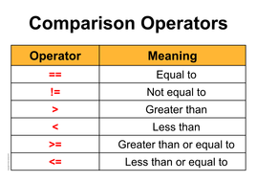
Notes:
Along with the comparison operators,

Slide 58
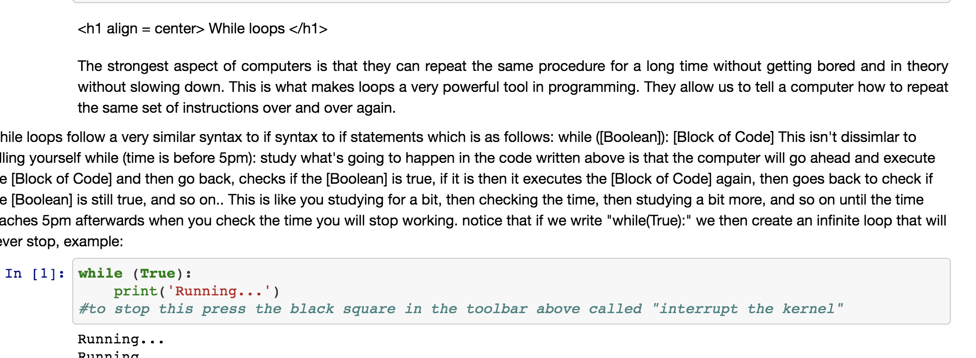
Work through the notebook until you hit “While Loops”
Run each cell and try to understand each line of code. Ask for help if you need it!
Notes:
So have a go at that until you hit Loops! While Loops! (10)

Slide 59
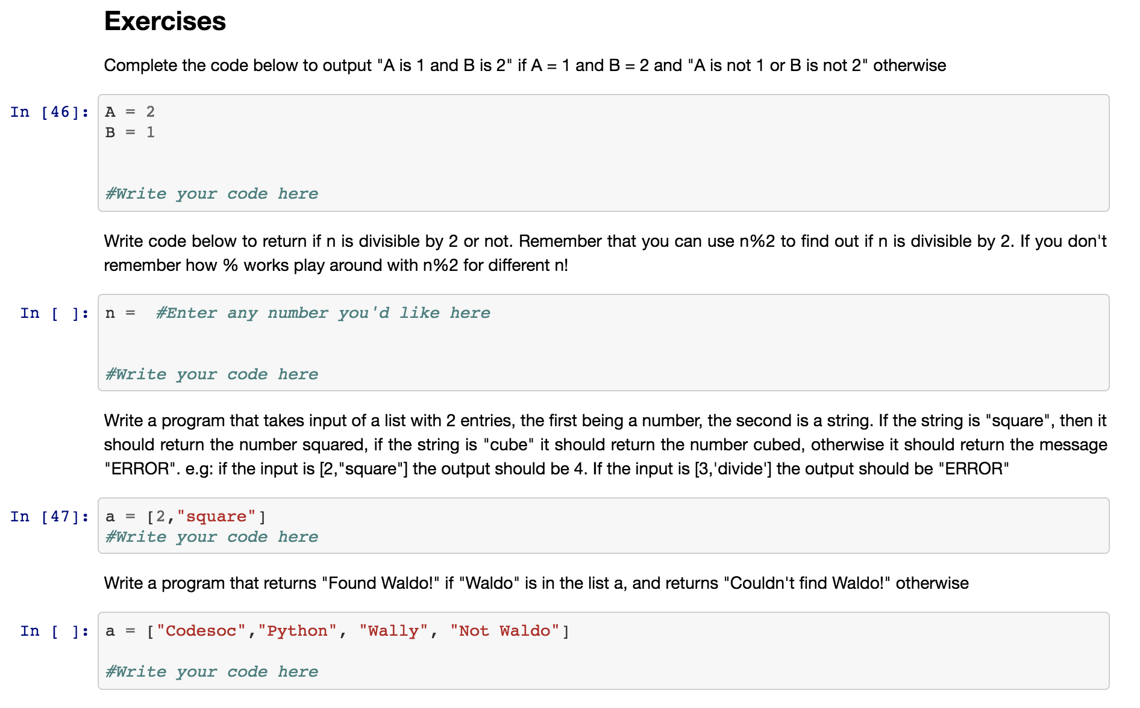
Notes:
The exercises for this one will be a bit harder, so let us know if you need any help. (10 minutes)

Slide 60
Loops!
Notes:
What if, we wanted to check a condition over and over again?

Slide 61
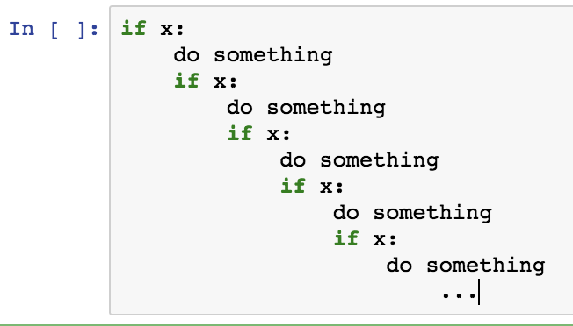
Notes:
What if, we wanted to check a condition over and over again?

Slide 62

Notes:
Say we’re programming a vacuum cleaner to do its job automatically.
You can imagine we’d like to tell it: As long the room is not clean, keep vacuuming.

Slide 63
Notes:
We could write a program kinda like this...

Slide 64
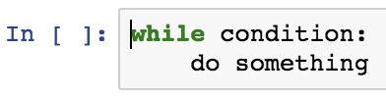
Notes:
Or we can invent a new tool to make our lives easier. The while loop.
So typically what you’ll have is
While some objective is not reached:
Work toward objective

Slide 65
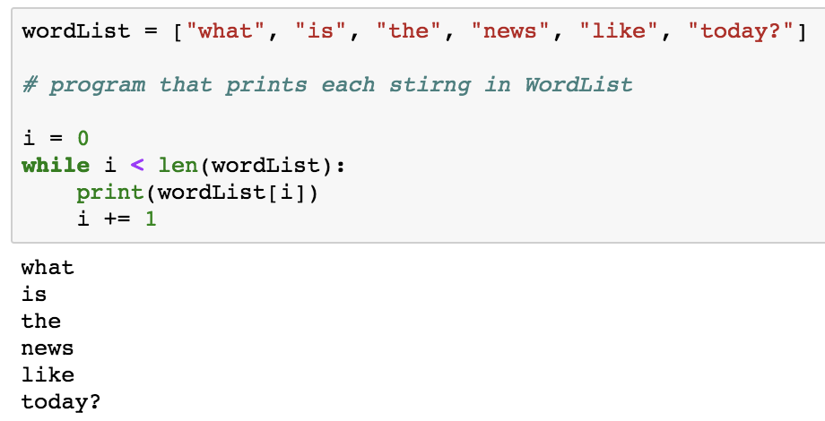

Slide 66
Memory
i = 0
wordList

Slide 67
len(wordList) = 6
Memory
i = 0
wordList

Slide 68
Memory
i = 0
wordList

Slide 69
Memory
i = 1
wordList

Slide 70
len(wordList) = 6
Memory
i = 1
wordList

Slide 71
Memory
i = 1
wordList

Slide 72
Memory
i = 2
wordList

Slide 73
len(wordList) = 6
Memory
i = 2
wordList

Slide 74
Memory
i = 2
wordList

Slide 75
Memory
i = 3
wordList

Slide 76
Memory
i = 4
wordList

Slide 77
Memory
i = 5
wordList

Slide 78
Memory
i = 6
wordList

Slide 79
6 < 6 is False
Memory
i = 6
wordList

Slide 80
Program Ends

Slide 81
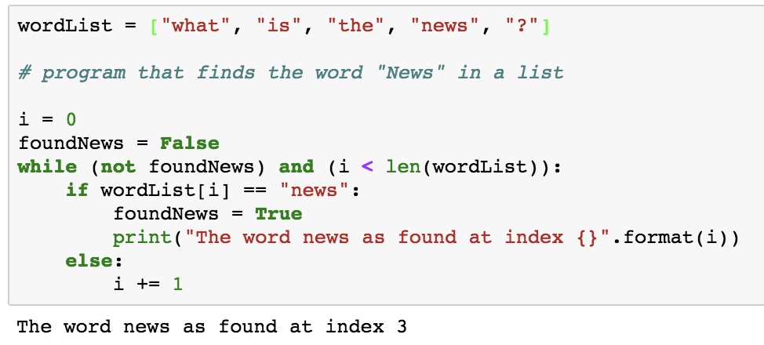

Slide 82
What makes reading code easy?
Sticking to conventions
Naming variables appropriately
Avoid making things more complicated than they have to be

Slide 83
Remainder of Part 2
And Part 3
Notes:
Let us know if you need a hand.

Slide 84
https://goo.gl/forms/MJs5QnmakIlXyk143
Notes:
Let us know if you need a hand.

